Slide 1



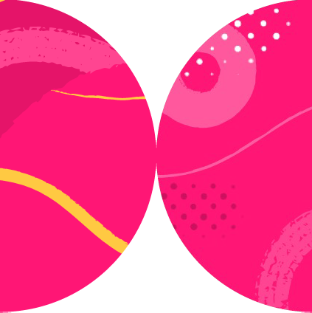

Overview of Generative Pre-trained Transformer (GPT) Models
Xavier Morera
Helping developers create epic applications
www.xaviermorera.com / www.bigdatainc.org / www.lupo.ai

Slide 2



Disclaimer:
This course is not a deep dive on the architecture of LLMs

Slide 3

Objective:
Learn how to develop a generative application using Python and the OpenAI API

Slide 4

What is a Generative Pre-trained Transformer (GPT) Model?

Slide 5
Disclaimer: Not everything that shines is gold

Slide 6

Hallucination

Slide 7

ar)(i
V >cs> arXiv:1706.03762
Search...
All fields
v
Search
Help
I Advanced Search
Computer Science > Computation and Language
[Submitted on 12 Jun 2017 (vl), last revised 2 Aug 2023 (this version, v7)]
Attention Is All You Need
Access Paper:
Download PDF
PostScript
Other Formats
Ashish Vaswani, Noam Shazeer, Niki Parmar, Jakob Uszkoreit, LIion Jones, Aidan N. Gomez, Lukasz Kaiser, lllia Polosukhin
(view license)
The dominant sequence transduction models are based on complex recurrent or convolutional neural networks in an encoder-decoder configuration. The best performing models also connect the encoder and decoder through an attention mechanism. We propose a new simple network architecture, the Transformer, based solely on attention mechanisms, dispensing with recurrence and convolutions entirely. Experiments on two machine translation tasks show these models to be superior in quality while being more parallelizable and requiring significantly less time to train. Our model achieves 28.4 BLEU on the WMT 2014 English-to-German translation task, improving over the existing best results, including ensembles by over 2 BLEU. On the WMT 2014 English-to-French translation task, our model establishes a new single-model state-of-the-art BLEU score of 41.8 after training for 3.5 days on eight CPUs, a small fraction of the training costs of the best models from the literature. We show that the Transformer generalizes well to other tasks by applying it successfully to English constituency parsing both with large and limited training data.
Current browse context: cs.CL
< prev next> new I recent I 1706
Change to browse by: cs
cs.LG
References & Citations
NASA ADS
Google Scholar
Semantic Scholar
99 blog linkS(whatisthis?)
DBLP - CS Bibliography
listing I bibtex
Ashish Vaswani Noam Shazeer Niki Parmar Jakob Uszkoreit LIion Jones
Comments: 15 pages, 5 figures
Subjects: Cite as:
Computation and Language (cs.CL); Machine Learning (cs.LG) arXiv:1706.03 762 [cs.CL]
(or arXiv:1706.03762v7 [cs.CL] for this version) https:/ /doi.org/ 10.48550/arXiv.1706.03762 C,
Submission history
From: LIion Jones [view email]
[vl] Mon, 12 Jun 2017 17:57:34 UTC (1,102 KB)
[v2] Mon, 19 Jun 2017 16:49:45 UTC {1,125 KB)
[v3] Tue, 20 Jun 2017 05:20:02 UTC (1,125 KB)
[v4] Fri, 30 Jun 2017 17:29:30 UTC {1,124 KB)
[vS] Wed, 6 Dec 2017 03:30:32 UTC (1,124 KB)
[v6] Mon, 24 Jul 2023 00:48:54 UTC (1,124 KB)
[v7] Wed, 2 Aug 202 3 00:41:18 UTC (1,124 KB)
Export BibTeX Citation
Bookmark
,¢}
Bibliographic Tools
Code. Data, Media
Demos
Related Papers
About arXivlabs
Bibliographic and Citation Tools
Bibliographic Explorer (What is the Explorer?)
Litmaps (What is Litmaps?)

Slide 8

GPT
Generative
Pre-trained
Transformer

Slide 9

Architecture of Large Language Models

Slide 10
Architecture of Large Language Models
Neural Networks
Attention Mechanisms

Slide 11
Architecture of Large Language Models
Transformer

Slide 12

{I) Cornell University
We gratefully acknowledge support from the Simons Foundation,
institutions, and all contributors
member
. | Dona | te
ar,}(i V
>cs> arXiv: | 1706. | 03762
Search
All fields
V
Search
Help I Advanced Search
Computer Science > Computation and Language
[Submitted on 12 Jun 2017(v1), last rewsed 2 Aug 2023 (this version, vl)J
Attention Is All You Need
Ashish Vaswani, Noam Shazeer, Niki Parmar, Jakob Uszkoreit, Llion Jones, Aidan N. Gomez, Lukasz Kaiser, lllia Polosukhin
Access Paper:
Download PDF
Postscript
Other Formats
(v ev, ,cen!;e)
The dominant sequence transduction models are based on complex recurrent or convolutional neural networks in an encoder-decoder configuration. The best performing models also connect the encoder and decoder through an attention mechanism. We propose a new simple netiNork architecture, the Transformer, based solely on attention mechanisms, dispensin,g,vith recurrence and convolutions entirely. Experiments on two machine translation tasks show these models to be superior in quality While being more parallelizable and requiring significantly less time to train. Our model achieves 28.4 BLEU on the WMT 2014 English-to-German translation task, improving over the existing best results, including ensembles by over 2 BLEU. On the WMT 2014 English-to-French translation task, our model establishes a new single-model state-of-the-art BLEU score of 41.8 after training for 3.5 days on eight GPUs, a small fraction of the training costs of the best models from the literature. We show that the Transformer generalizes well to other tasks by applying it successfully to English constituency parsing both with large and limited training data.
Current browse context: cs.Cl
< prev
next>
new I recent 11706
Change to browse by: cs
cs.LG
Comments: 15 pages. 5 figures
References & Citations
Subjects: Cite as:
Computation and Language (cs.CL); Machine Learning (cs.LG) arXiv:1706 03762 [cs.CL]
(or arXiv:1706.03762v7 [cs.CL] for this version) https://doi.org/10.48550/arXiv.1706.037628
NASAADS
Google Scholar
Semantic Scholar
98 blog links<vma11s1t.3?)
DBLP - CS Bibliography
listing I bibtex
Ashish Vaswani Noam Shazeer Niki Parmar Jakob Uszkoreit Llion Jones
Submission history
From: Llion Jones [view email]
[v1] Mon, 12 Jun 2017 17:57:34 UTC (1,102 KB)
[v2] Mon, 19 Jun 2017 16:49:45 UTC (1,125 KB)
[v3] Tue, 20 Jun 2017 05:20:02 UTC (1,125 KB)
[v4] Fri, 30 Jun 201717:29:30 UTC (1,124 KB)
[v5] Wed, 6 Dec 2017 03:30:32 UTC (1,124 KB)
[v6] Mon, 24 Jul 2023 00:48:54 UTC (1,124 KB)
[v7] Wed, 2Aug 2023 00:41:18 UTC (1,124 KB)
Export BibTeX Citation
Bookmark
¢7
Bibliographic Tools
] Code, Data, Media Demos
Related Papers About arXivLabs
�--------------------------------------------------------------------------------------------,
Bibliographic and Citation Tools
Bibliographic Explorer (Whal is the Explorer?)
Litmaps (Whal is Lilmaps?)
scile Smart Citations (1/1/hat are Smart Ci1ations?)
Which authors of this paper are endorsers? I Disabfe MathJax (What 1s MathJax?)

Slide 13

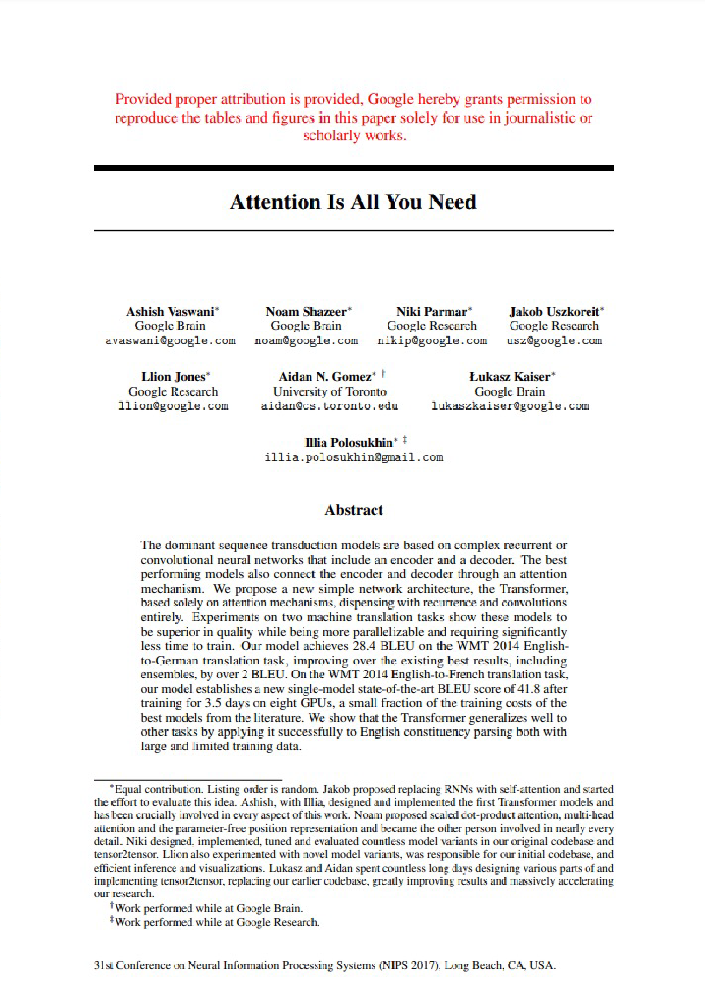
Attention Is All You Need
The transformer is the foundation for many LLMs due to its parallel processing capabilities and efficient attention mechanisms.

Slide 14
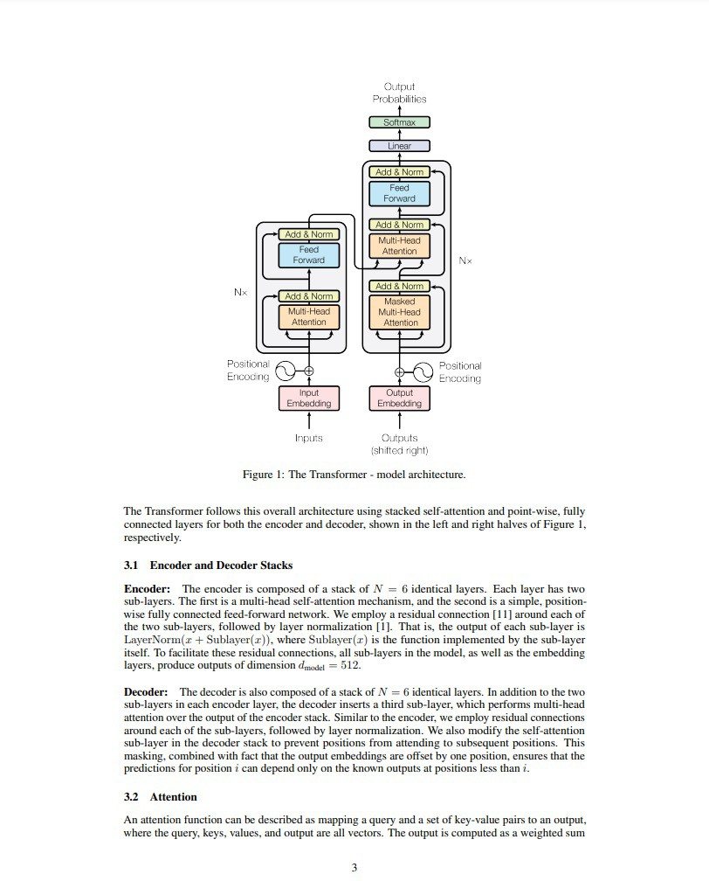
Transformer Architecture

Slide 15
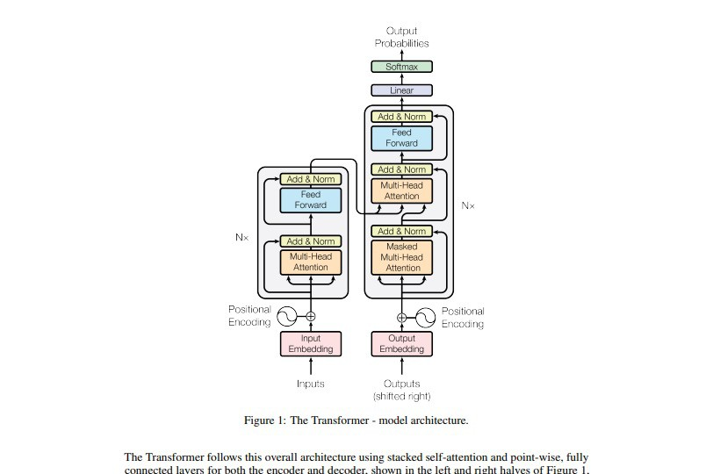
Transformer Architecture

Slide 16

Transformer Architecture
Output Probabilities
Softmax Linear
Add & Norm Feed Forward
Add & Norm
Multi-Head Attention
Add & Norm
Feed Forward
Nx
Add & Norm
Masked Multi-Head Attention
Nx
Add & Norm
Multi-Head Attention
Positional Encoding
Input Embedding
Positional Encoding
Output Embedding Outputs
(shifted right)
Inputs
https://arxiv.org/pdf/1706.03762.pdf

Slide 17
Transformer Architecture
Encoder-decoder structure
Self-attention mechanism
Multi-head attention
Positional encoding
Feed-forward neural networks

Slide 18

Encoder-Decoder Structure
Responsible for processing text
Generates output text
Encoder
Decoder

Slide 19
Self-Attention Mechanism
Allows the model to weigh the importance of different words in a sentence relative to each other
Enables the model to capture contextual relationships and dependencies effectively

Slide 20



Self-Attention Mechanism
Each word in a sentence looks at all the other words in the same sentence
Figures out how much attention or importance it should give to each of those other words
Then, it combines information from all those other words based on their importance to get a better understanding of the whole sentence

Slide 21
Multi-Head Attention
To capture different types of relationships, the Transformer employs multi-head attention
Performs self-attention multiple times in parallel, allowing the model to focus on different parts of the input simultaneously

Slide 22




Multi-Head Attention
Imagine that you have a complex book to read
You divide the book between you and a few friends
Each one of you reads a story and understands it
And then your friends help you understand the whole story

Slide 23
Positional Encoding
The Transformer doesn't inherently understand the sequential order of words
Positional encoding is added to the input embeddings
Helps the model differentiate between the positions of words in the sequence

Slide 24
Positional Encoding
In simpler words…

Slide 25
Positional Encoding
In simpler words…
1 2 3

Slide 26
Feed-forward Neural Networks
Each layer of the Transformer includes feed-forward neural networks
Process the attention outputs and apply non-linear transformations to capture complex patterns

Slide 27


Feed-forward Neural Networks

Slide 28
Transformer Architecture (In Simpler Words)

Slide 29
At a High Level
Splitting sentences
Attention
Mixing information
Repeat for understanding

Slide 30
Evolution of the GPT Model Family

Slide 31
Evolution of the GPT Model Family
GPT-1 (2018)
117 million params Trained on ~40GB
Context length of 512 tokens
GPT-3 (2020)
175 billion params
Trained on over 570 GB of data
Notable improvements
GPT-4 (2023)
Largest milestone in the series
Multimodal capabilities Superior performance
GPT-2 (2019)
1.5 billion params
Focused on improved training Double the input size
Enhanced performance
GPT-3.5 (2022)
Multiple variants
Based on GPT-3 with an emphasis on ethical considerations
Additional improvements
The Future…
Let’s wait and see

Slide 32
Evolution of the GPT Model Family
GPT-1 (2018)
117 million params Trained on ~40GB
Context length of 512 tokens
GPT-3 (2020)
175 billion params
Trained on over 570 GB of data
Notable improvements
GPT-4 (2023)
Largest milestone in the series
Multimodal capabilities Superior performance
GPT-2 (2019)
1.5 billion params
Focused on improved training Double the input size
Enhanced performance
GPT-3.5 (2022)
Multiple variants
Based on GPT-3 with an emphasis on ethical considerations
Additional improvements
The Future…
Let’s wait and see

Slide 33
Evolution of the GPT Model Family
GPT-1 (2018)
117 million params Trained on ~40GB
Context length of 512 tokens
GPT-3 (2020)
175 billion params
Trained on over 570 GB of data
Notable improvements
GPT-4 (2023)
Largest milestone in the series
Multimodal capabilities Superior performance
GPT-2 (2019)
1.5 billion params
Focused on improved training Double the input size
Enhanced performance
GPT-3.5 (2022)
Multiple variants
Based on GPT-3 with an emphasis on ethical considerations
Additional improvements
The Future…
Let’s wait and see

Slide 34
Evolution of the GPT Model Family
GPT-1 (2018)
117 million params Trained on ~40GB
Context length of 512 tokens
GPT-3 (2020)
175 billion params
Trained on over 570 GB of data
Notable improvements
GPT-4 (2023)
Largest milestone in the series
Multimodal capabilities Superior performance
GPT-2 (2019)
1.5 billion params
Focused on improved training Double the input size
Enhanced performance
GPT-3.5 (2022)
Multiple variants
Based on GPT-3 with an emphasis on ethical considerations
Additional improvements
The Future…
Let’s wait and see

Slide 35
Evolution of the GPT Model Family
GPT-1 (2018)
117 million params Trained on ~40GB
Context length of 512 tokens
GPT-3 (2020)
175 billion params
Trained on over 570 GB of data
Notable improvements
GPT-4 (2023)
Largest milestone in the series
Multimodal capabilities Superior performance
GPT-2 (2019)
1.5 billion params
Focused on improved training Double the input size
Enhanced performance
GPT-3.5 (2022)
Multiple variants
Based on GPT-3 with an emphasis on ethical considerations
Additional improvements
The Future…
Let’s wait and see

Slide 36
Evolution of the GPT Model Family
GPT-1 (2018)
117 million params Trained on ~40GB
Context length of 512 tokens
GPT-3 (2020)
175 billion params
Trained on over 570 GB of data
Notable improvements
GPT-4 (2023)
Largest milestone in the series
Multimodal capabilities Superior performance
GPT-2 (2019)
1.5 billion params
Focused on improved training Double the input size
Enhanced performance
GPT-3.5 (2022)
Multiple variants
Based on GPT-3 with an emphasis on ethical considerations
Additional improvements
The Future…
Let’s wait and see

Slide 37
Impact of Model Size on Performance

Slide 38


Impact of Model Size on Performance
Enhanced contextual understanding
Improved text generation Complex task handling Broadened multilingual support
Challenges and trade-offs

Slide 39
Basics of Generative Pre-trained Transformer (GPT) Models

Slide 40

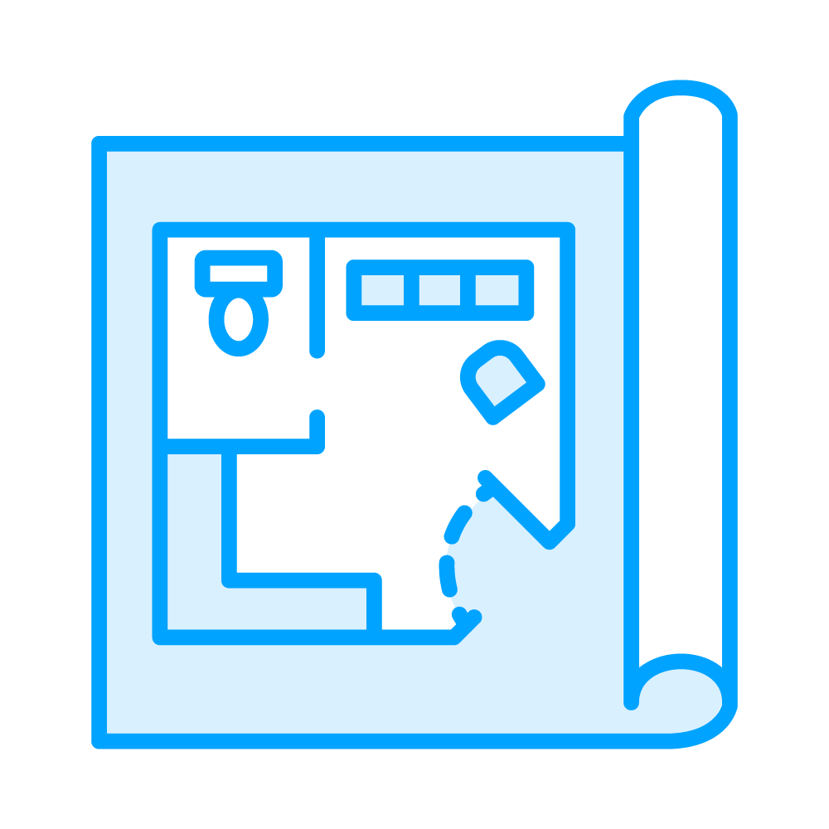
Understanding GPT Models

Slide 41

Understanding GPT Models
Pivotal advancement in NLP tasks
Transformers employ self-attention mechanisms
- Capture intricate contextual relationships among words within sentences

Slide 42
The Process: Making It All Work
Models learn language patterns and contextual comprehension from extensive text data
Tailors the model to specific tasks, making it adaptable and versatile
Pre-training
Fine-tuning

Slide 43
The attention mechanism
Empowers GPT models to weigh the significance of each word within a sentence
In relation to others
This dynamic understanding of context
Enhances the models' ability to generate coherent and contextually fitting text
Unveiling Attention Mechanisms

Slide 44
GPT models employ embeddings to represent words as continuous vectors in a high- dimensional space
Significance of Embeddings
These embeddings capture semantic relationships
- Enabling the model to grasp word meanings and contextual intricacies

Slide 45
GPT models generate text autoregressively
Predicting each word based on the previous words
Ensures that generated text flows cohesively
Maintaining contextual coherence
Autoregressive Text Generation

Slide 46
Different sampling strategies influence the creativity and randomness of generated text
Strategies for Text Sampling
You can set how “creative” the response should be
Techniques to control output
Temperature scaling and top-k sampling

Slide 47
Use Cases and Applications
Language Translation
Text Generation
Question Answering

Slide 48
Overview of Rival Language Models (LLMs)

Slide 49
Talk to Claude
ANTHROP\C
Email
l Email address
]
Continue with email
OIR
G Continue with Google
Claude.ai is currently in open beta and usage of the platform may be limited for unpaid users.
Claude for Business
Constitutional Al
Claude is a next-generation AI assistant for your tasks, no matter the scale. Our API is currently being offered to a limited set of customers and researchers.
Constitutional AI (CAI) shapes the outputs of AI systems according to a set of principles, with the goal of making a helpful, harmless, and honest AI assistant.
Browse our products
Learn about CAI

Slide 50


p What is Claude?v
A\
What is Claude? 0
I'm Claude₁ an AI assistant created by Anthropic.
A\ □ Copy
[Q
What can you do? 0
I'm designed to be helpful, harmless, and honest. I can have natural conversations, answer questions factually, and provide useful information to users.
□ Copy
A\
Are you better than ChatGPT? 0
I'm an different AI system created by a different company so it's hard to make a direct
1
comparison. ChatGPT is very impressive in many ways, but all AI systems have strengths and limitations. My goal is to be as helpful₁ harmless and honest as possible when
conversing with users.
□ Copy
What are your key advantages over the other LLMs? 0
I don't have a full comparison to other lar-ge language models, but some key things about m1e:
A\
I was created by Anthropic to be helpful₁ harmless, and honest through a technique called Constitutional AL This focuses me on being:a positive conversational agent.
I have a more advanced natural language pr-ocessing system compared to other chatbots, so I can understand and respond to complex conversations more
n:=itt 11r:=illv
!Message Claude...
to send, shift + cJ to add a new line, Ctrl + K to create a new chat

Slide 51

A\
p What is Claude?v
A\
Ll Copy
Are you better than ChatGPT? I)
I'm an different AI system created by a different company, so it's hard to make a direct comparison. Chat,GPT is very impressive in many ways, but all AI systems have stren,gths and limitations. My goal is to be as helpfut harmless and honest as possible when conversing with users.
A\ Ll Copy
What are your key advantages over the other LLMs? I)
I don't have a full comparison to other lar-ge language models, but some key things about m1e:
I was created by Anthropic to be helpful, harmless, and honest through a technique called Constitutional Al This focuses me on being a positive conversational agent.
I have a more advanced natural language processing system compared to other chatbots, so I can understand and respond to complex conversations more naturally.
I have training and techniques to avoid various types of harmful, biased or unreliable responses that can occur in Al systems.
I'm constantly learning and improving based on my conversations to become more useful over time..
Overall] aim for useful, benign and trustworthy dialog. But capabilities of AI systems are rapidly evolvingi, so direct comparisons are difficult. My focus is on having the most positive and productive conversations I can.
A\ Ll Copy ':) Retry
Message Claude...
cl to send, shift + c!I to add a new line, Ctrl + K to create a new chat

Slide 52
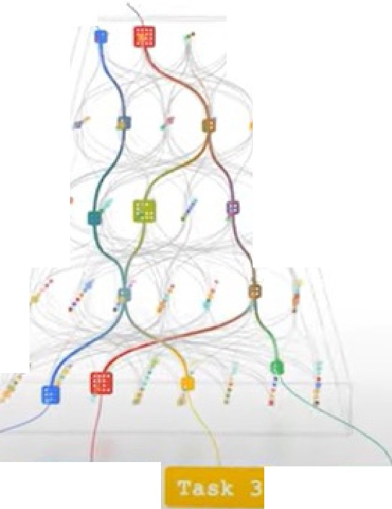
Google The Keyword
Latest stories
Product updates v
Company news v
a..
Subscribe
Al
Introducing Pathways: A next­ generation Al architecture
Oct 28, 2021
5 min read
Too often, machine learning systems overspecialize at individual tasks, when they could excel at many. That's why we're buildi11g Pathways-a new Al architecture that willl handle many tasks at once, learn new tasks quickly and reflect a better understanding of the world.
Jeff Dean
Google Senior Fellow and SVP, Google Research
«: Share
-
..
•
41-Hii if.EIMI
if.iliii
Pa

Slide 53





Go gle Al
Why Al Responsibility
Discover
Build
•
... ...
••
Al ACROSS GOOGLE:
PaLM 2
PaLM 2 is our next generation large language model that builds on Google's legacy of breakthrough research in machine learning and responsible Al.
t·········•··············
··•...... •
·········•,...•.......
It excels at advanced reasoning tasks, including code and math, classification and question answering, translation and multilingual proficiency, and natural language generation better than our previous state­ of-the-art LLMs, including PallM. It can accomplish these tasks because of the way it was built - bringing together compute-optimal scaling, an improved dataset mixture, and model architecture improvements.
PaLM 2 is grounded in Google's approach to building and deploying Al responsibly. All versions of PalM 2 are evaluated rigorously for potential harms and biases, capabilities and downstream uses in research and in-product applications. PaLM 2 is used in other state-of-the-art models, like Sec-PaLM. We continue to implement the latest versions of PaLM 2 in generative Al tools like the PaLM API and Bard.
fRe. searcHI
ytes JI
_DX

Slide 54




...
Bard (Experiment J
•••
+ Nlew chat
What is the difference between Palm and Bard?
Recent
D PaLM vs. Bard
View other drafts v
•♦
PaLM (Pathways Language Model) is a llarge language model (LLM) developed by Google Al. It was trained on a massive dataset of text and code, and can generate text, translate languages, write different kinds of creative content, and answer your questions in an informative way. PaLM is still under development, but it has !learned to perform many kinds of tasks, including:
Following instructions and completing requests thoughtfully
Answering questions in a comprehensive and informative way, even if they are open ended, challenging, or strange
Generating different creative text formats of text content, like poems, code, scripts, musical pieces, email, !letters, etc.
Bard is also an LLM developed by Google Al, but it is based on a newer model called PaLM 2. P'aLM 2 is better at common sense reasoning, logic and mathematics compared to previous modells. Bard also has access to and processes information from the real world through Google Search, wriich allows it to provide more comprehensive and up-to-date answers to your questions.
In summary, here are the main differences between PaLM and Bard:
Model: Bard is based on PaLM 2, a newer and more advanced model than PaLM.
Capabilities: Bard is better at common sense reasoning, logic, and matlhematics than PaLM. Bard also has access to and processes information from the real world through Googlle Search.
Use cases: Bard is we!ll-suited for tasks that require common sense reasoning, llogic, mathematics, oir access to real-world information. PaLM is welll-suited for tasks that require generating creativ,e text formats or trnnslating languages.
It is important to note that both PaLM and Bard are still under development, and their capabilities are constantly improving.
G.i 0nter aprompt here
Draper. UT. USA
From your IP address· Update location
Bard may display inaccurate or offensive information that doesn't represent Google's views. Bard PrivacY.Notice

Slide 55
OOMetaAI
Research
Blog
Resources
About
Introducing Llama 2
The next generation of our open source large language model
Llama 2 is available for free for research and commercial use.
Download the Model
,1.. Learn more about Llama 2
The Model
Partnerships
Responsibility
Download the Model
Resources
Inside the model
This release includes model weights and starting code for pretrained and fine-tuned Llama language models (Llama Chat, Code Llama) - ranging from 7B to 70B parameters.

Slide 56

The Game-Changing Role of Large Language Models

Slide 57

Demo
Demo from ChatGPT to the OpenAI API

